Slide 1
Genetic Algorithms

Slide 2
References
The model of weights optimization based on genetic algorithm
Using Multiple Criteria Optimisation and Two-Stage Genetic Algorithms to Select a Population Management Strategy with Optimized Reliability
Multi-Objective Optimization Using Genetic Algorithms: A Tutorial
“Artificial Intelligence” by Elaine Rich, Kevin Knight & Shivashankar B Nair
https://www.tutorialspoint.com/genetic_algorithms/

Slide 3
What are Genetic Algorithms?
Genetic Algorithms are search based algorithms based on the concepts of natural selection and genetics.
Genetic Algorithms is a family of meta-heuristics that belong to the larger class of evolutionary algorithms.
Genetic Algorithms perform well in approximating solutions to all types of problems because it doesn’t make assumptions about the fitness landscape.

Slide 4
Technical Terminologies
Population: It is an array of individuals in each generation.
Individual: Each individual contains chromosome(s) which represents a point solution in a multidimensional space.
Chromosome: An array of genes is known as a chromosome.
Genes: Values are stored inside chromosomes in genes.
Alleles: The values which are stored in genes are known as alleles.

Slide 5
Technical Terminologies (contd.)
Fitness: It is s value associated with an individual on the basis of a fitness function. Optimization of this value acts as a heuristic to the search.
Fitness Function: Also known as the objective function, it associates the value of the genes of an individual to a fitness value, which has to be optimised.

Slide 6
Technical Terminologies (contd.)
Generation: At each iteration, a genetic algorithm performs a series of computations on the current population to produce a new population. Each successive population is called a new Generation.
Diversity: It refers to the average distance between individuals in a population.
Parents & Children: To create the next generation, the algorithm selects certain individuals in the current population, these are called Parents, which are used to create individuals in the next generation which will be known as Children.

Slide 7
How does a Genetic Algorithm Work?
The GA repeatedly modifies a population of individual solutions.
At each step, it selects individuals from the current population to be parents and uses them to produce the children for the next generation.
These children replace the individuals which are not chosen by survivor selection rules and thus the population size remains constant.
Over successive generations, the population "evolves" toward an optimal solution.

Slide 8
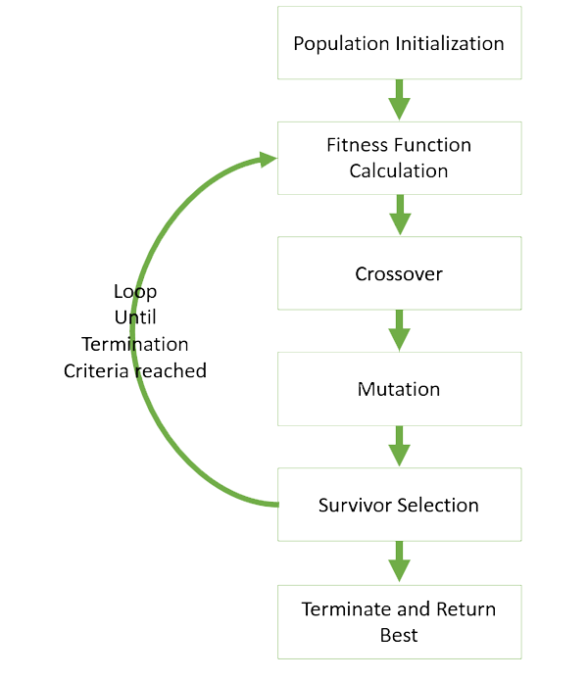
Flowchart of a Basic Genetic Algorithm

Slide 9
Continue for detailed description,
else click the skip button below:
>>Skip>>

Slide 10
Parameters of a Genetic Algorithm
Probability of Crossover: This parameter tells us how much composition of the next generation will be new children. This is usually high.
Probability of Mutation: This parameter tells us by how much probability, the children will be mutated. This is usually very low.
Crossover Operator: The operator used to perform crossovers.
Mutation Operator: The operator used to perform mutation.
Selection Rules: The rules used for parent and survivor selections, etc.

Slide 11
Parent Selection
Fitness Proportionate Selection: Every individual can become a parent with a probability which is proportional to its fitness.
Roulette Wheel Selection: circular wheel is divided into sectors on the basis of fitness. A fixed point is chosen on the wheel circumference and the wheel is rotated. The region of the wheel which comes in front of the fixed point is chosen as the parent. For the second parent, the same process is repeated.
Stochastic Universal Sampling: Instead of having just one fixed point, we have multiple fixed points.

Slide 12
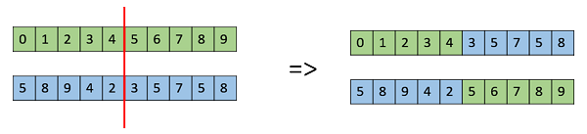
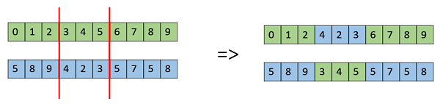
Crossover
One Point Crossover:
Multi Point Crossover

Slide 13

Crossover (contd.)
Uniform Crossover:
Whole Arithmetic Recombination:
Child1 = a.x + (1-a).y
Child2 = a.y + (1-a).x
There exist a lot of other crossovers like Partially Mapped Crossover, Order based crossover (OX2), Shuffle Crossover, Ring Crossover, etc.

Slide 14
Mutation
Bit Flip Mutation
Swap Mutation
Scramble Mutation

Slide 15
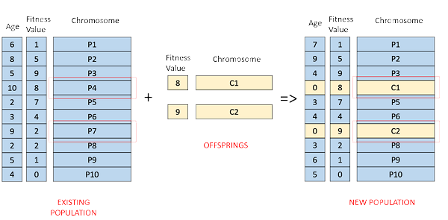
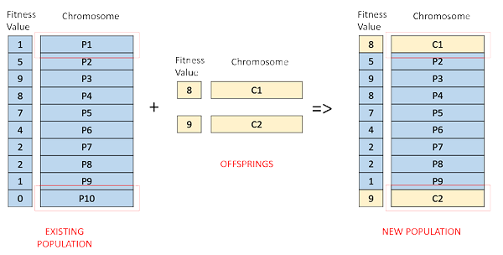
Survivor Selection
Age Based Selection:
Fitness Based Selection :

Slide 16
Termination Conditions
Usually, we keep one of the following termination conditions:
When there has been no improvement in the population for X iterations.
When we reach an absolute number of generations.
When the objective function value has reached a certain predefined value.

Slide 17
Why Use Genetic Algorithm here?
We have chosen multiple parameters for finding ELO to rank projects.
These parameters have different value and ranges.
What the genetic algorithm is doing, is finding weightage of each parameter (w1, w2, …, wN in calculation of ELO.
ELO = w1*p1 + w2*p2 + … +wN*pN.

Slide 18
Why Use Genetic Algorithm here? (contd.)
As of now, ELO is decided by 6 parameters, so algorithm searches for a single point, representing a set of weights (one for each parameter) in 6 Dimensional space.
This search is run by comparing generated ranks with already ranked training set, using Kendall tau rank correlation coefficient for the first run, then another GA runs in a long interval to take previous output as input to reiterate on the weights and to take into account the change in trends.

Slide 19
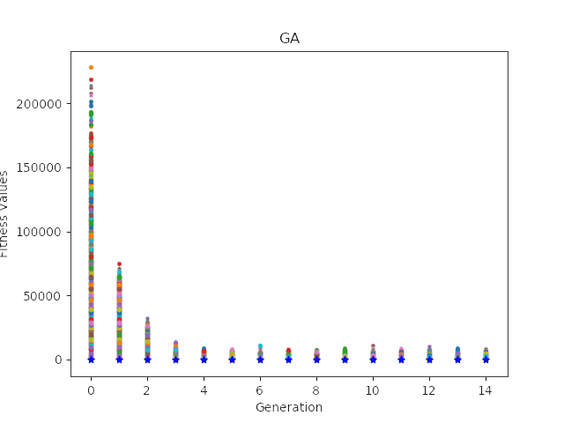
Results Obtained
Time taken for 1000 individuals: 3 minutes 11 seconds
Visualized output:

Slide 20
Disadvantages
It’s really hard to come up with a good heuristic which reflects what we want the algorithm to do.
It might not find the most optimal solution to the defined problem in all cases.
It’s also hard to choose parameters like number of generations, population size, etc.
Being stochastic, there are no guarantees on the optimality or the quality of the solution.

Slide 21
Thank You!

Slide 22
Please Press Escape ;)

